Slide 1
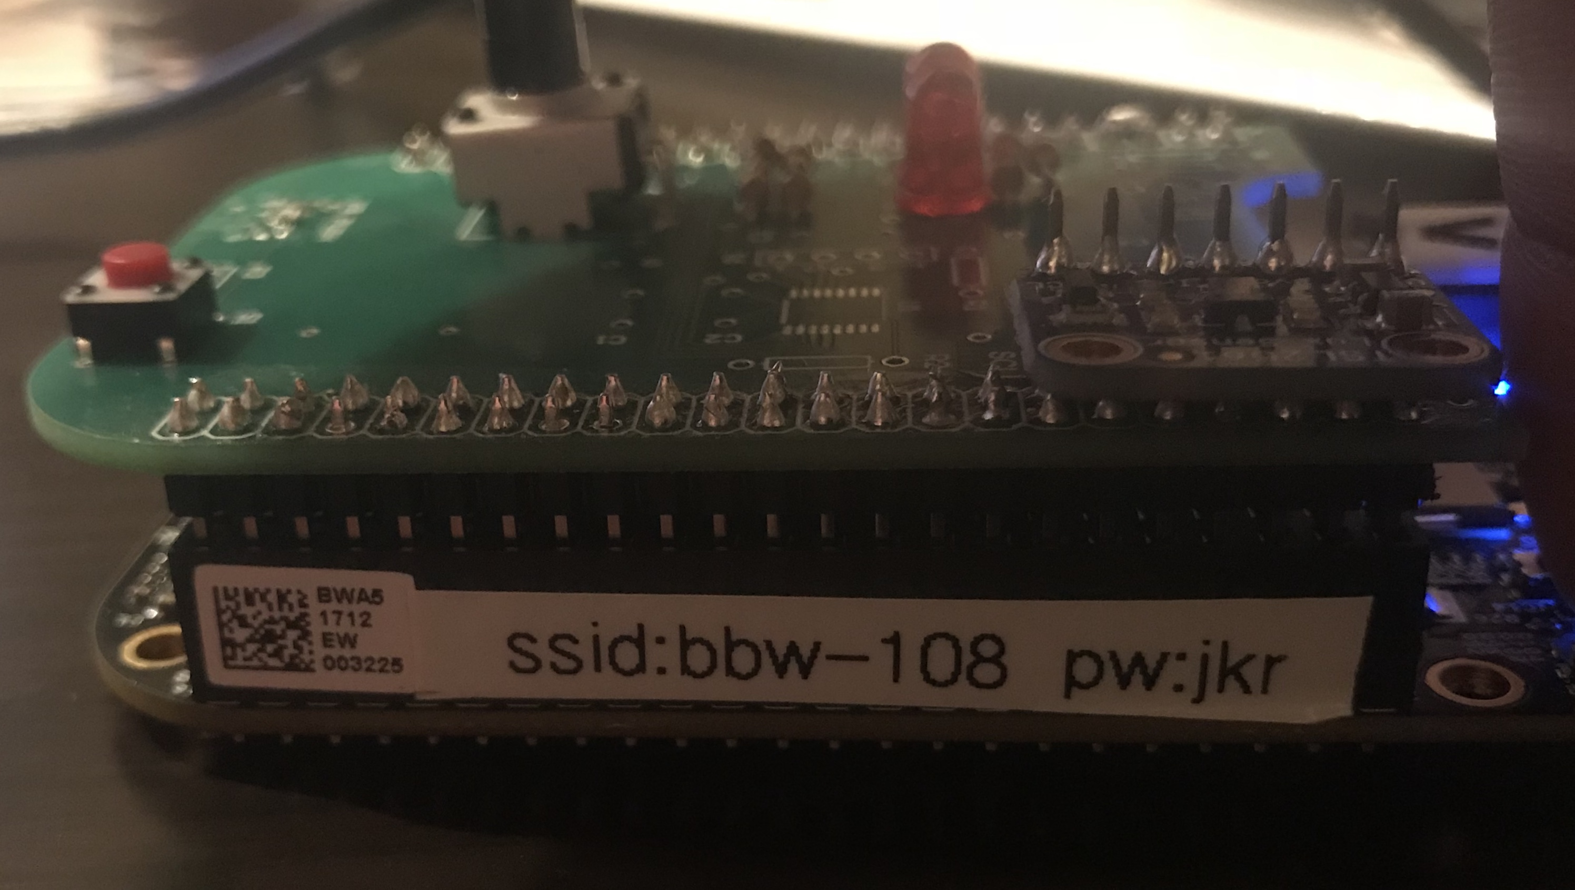
Pre-Workshop Setup
Power On Beaglebone Black Wireless
Connect USB cable to board
Connect other end of USB cable to PC
Download Presentation, files and Read Python Tutorial
Go to https://goo.gl/p3Su87
Download presentation (pptx/pdf)
Download bopit.zip and extract bopit.zip
Read https://goo.gl/SnbG6M
Connect to Beaglebone Black Wireless access point
Wait ~4 minutes after your board has been powered on
Connect to board’s wifi access point
Wifi ssid is what you see on the board’s label as “ssid:”
Passcode is beaglebone_ then add what you see on the label.
For the above image the password would be “beaglebone_jkr”

Slide 2



Super Introduction to Embedded Linux Workshop
Franklin Cooper
University Marketing Manager
<number>

Slide 3
Goals
Learn to use Beaglebone Black wireless
Play BopIt Game (using Computer Mouse)
Learn how to control peripherals via Python
Play BopIt Game (using Beaglebone Sensors)

Slide 4
Python
If your not family with Python
Ask a neighbor
Use a search engine
Quickly look at: https://goo.gl/SnbG6M

Slide 5
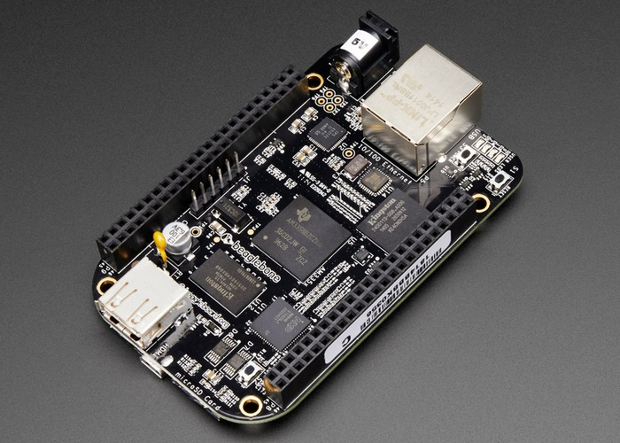
Beaglebone Black Wireless Quick Summary
Open Source Community Board
Uses Cortex A8 MPU
Runs at 1 GHz max
Access to 81 pins ie you can access a lot of peripherals
Integrated Wifi
Intergrated Bluetooth
<number>

Slide 6
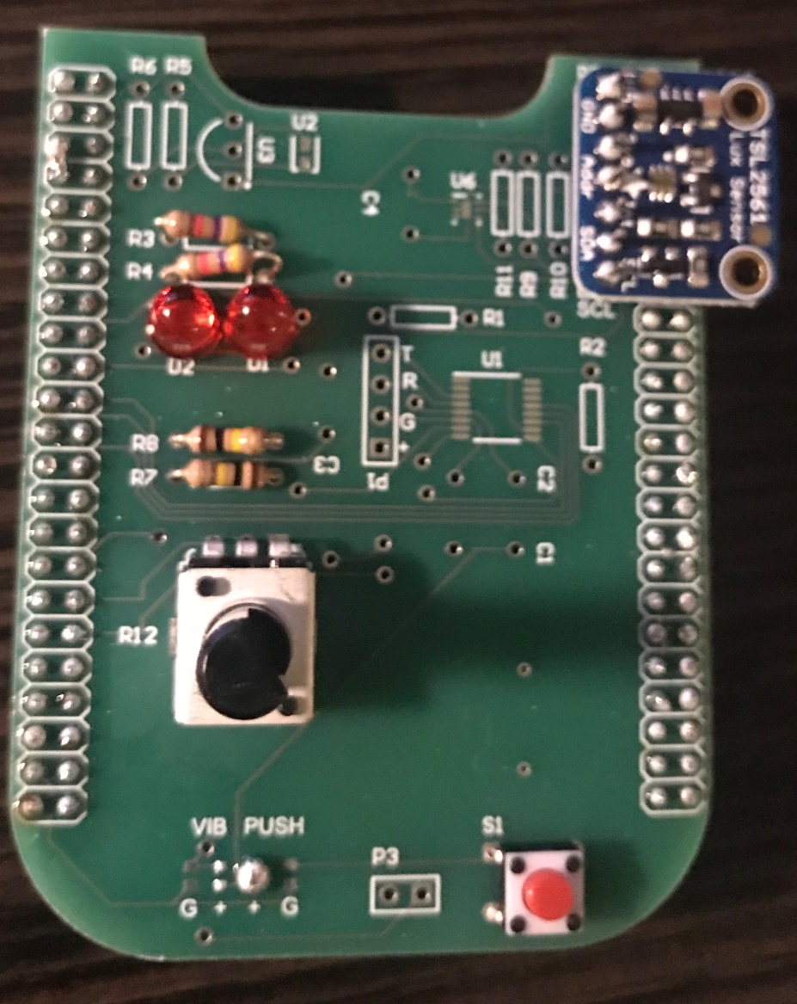
Beaglebone Workshop Cape
LED
Light Sensor
Connected to:
P9_46
Connected to:
P9_19
P9_20
Potentiometer
Connected to:
P9_36
Push Button
Connected to:
P9_29
<number>

Slide 7
Lets Get Started

Slide 8
Cloud 9 – Quick Summary
Browser Base IDE
Supported Languages:
Python
C
C++
and much more
Supports Debugging
<number>

Slide 9
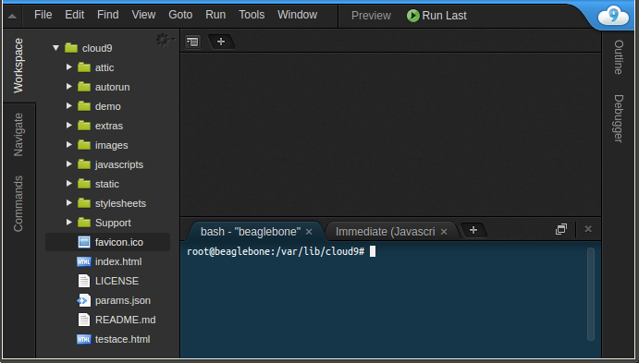
Task 1 – Connect to Cloud 9 IDE
Make sure your connected to your device’s wireless access point
If not see the first slide for instructions
Open up a web browser (don’t use IE)
Go to http://192.168.7.2:3000/ (May take 2-3 minutes for page to load)
You should see something like the below
<number>

Slide 10
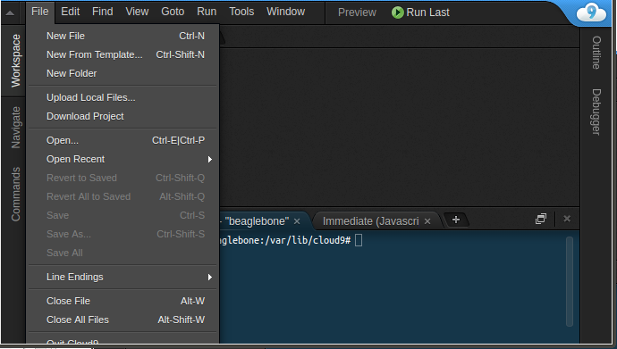
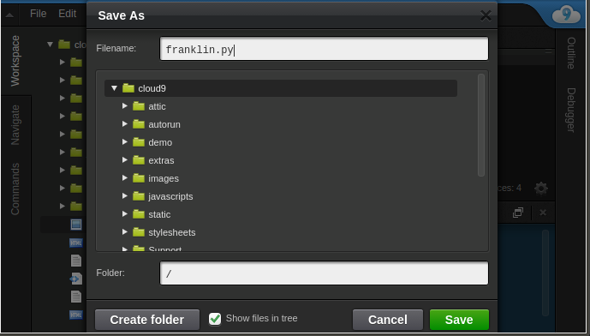
Cloud 9 – How to Create a New File
Create New File
Goto File->New File
Now Save File
Goto File->Save
Give file a name
MUST end with .py for Python programs
Hit green Save button
Shortcut to Save File
CTRL+S
<number>

Slide 11
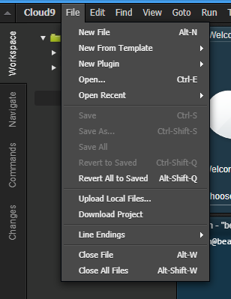
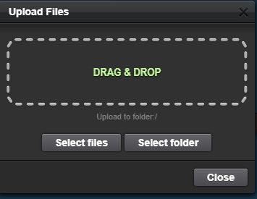
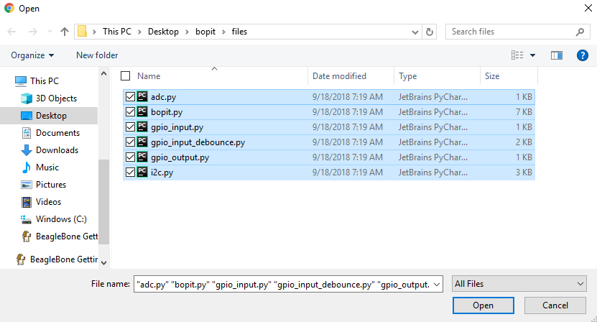
Cloud 9 – How to Import a File on Your PC
Upload Local File(s)
Goto File->Upload Local Files
Hit “Select files’
Navigate to the files you want to upload
Highlight all the files you want to upload
Hit Open
<number>

Slide 12
Task 2 – Import Workshop Files
Upload Local File(s)
Goto File->Upload Local Files
Hit “Select files’
Navigate to where you extracted bopit.zip
Go into the files directory
Highlight all Python files (ends in .py)
Hit Open
<number>

Slide 13
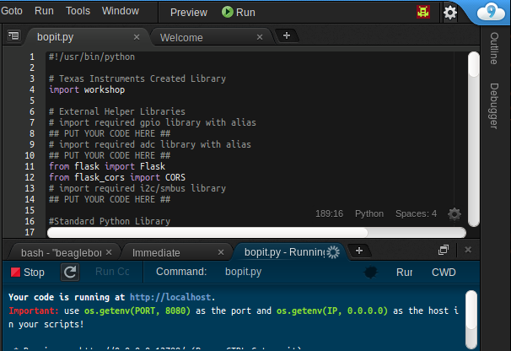
Cloud 9 – Running Program
Hit Run Button to “run your program”
* Important Tip*
Before running save your file first.
<number>

Slide 14
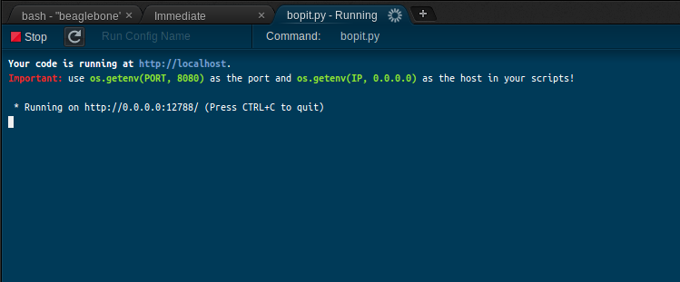
Task 3 – Run Bopit_board_test.py Program
Run the bopit_board_test.py program.
This will help verify your board is in working order.
<number>

Slide 15

Play Beaglebone Based Bop It
Goal :
Play Bop It using Push Button, Potentiometer and Light Sensor

Slide 16
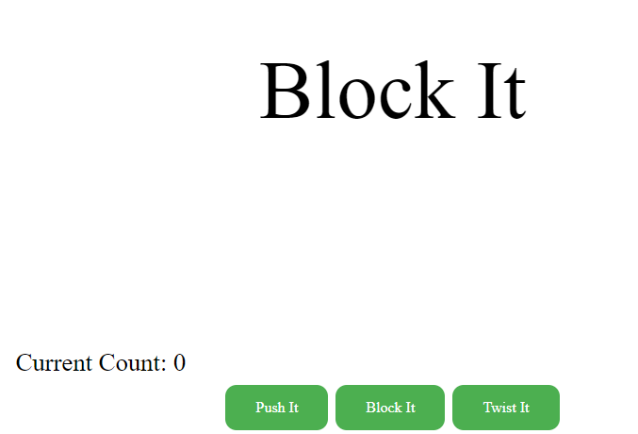
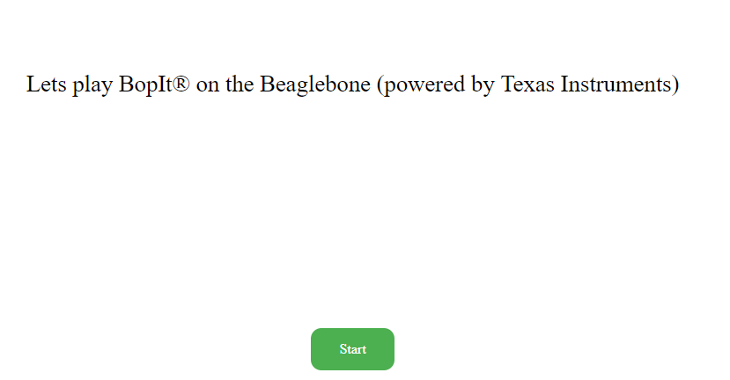
Task 4 – Play TI Beaglebone BopIt
Goto: http://192.168.7.2:8080/workshop/bopit/
Turn down your computer’s speaker (IMPORTANT)
Hit Start
You will see and/or hear a command
Hit the correct button below that corresponds with the command
<number>

Slide 17
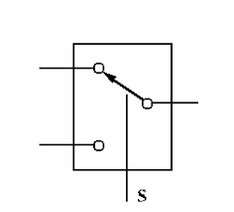
Hardware – Pinmux
Pinmuxing is when a signal can be connected via a mux (switch) to various other signals
gpio
P9_29
i2c_sda
Internal
(Inside Chip)
External
(What you can access)
Pinmuxing is used on almost every signal pin on the Beaglebone

Slide 18
Software – Pinmux
To simplify configure a pin’s pinmuxing you can use a program/script called config-pin
debian@beaglebone:~$ config-pin P9_14 pwm
debian@beaglebone:~$ config-pin -q P9_14
P9_14 Mode: pwm
debian@beaglebone:~$ config-pin -l P9_14
default gpio gpio_pu gpio_pd pwm
Set P9_14 to PWM
Get information regarding
P9_14 current setting
Output ->
Get list of modes you can
Set P9_14 to
Output ->
Python version (What you will be using)
workshop.setPinMux("P9_29","gpio")
Set P9_29 to gpio mode.
Modes you will use in this workshop:
gpio and i2c

Slide 19
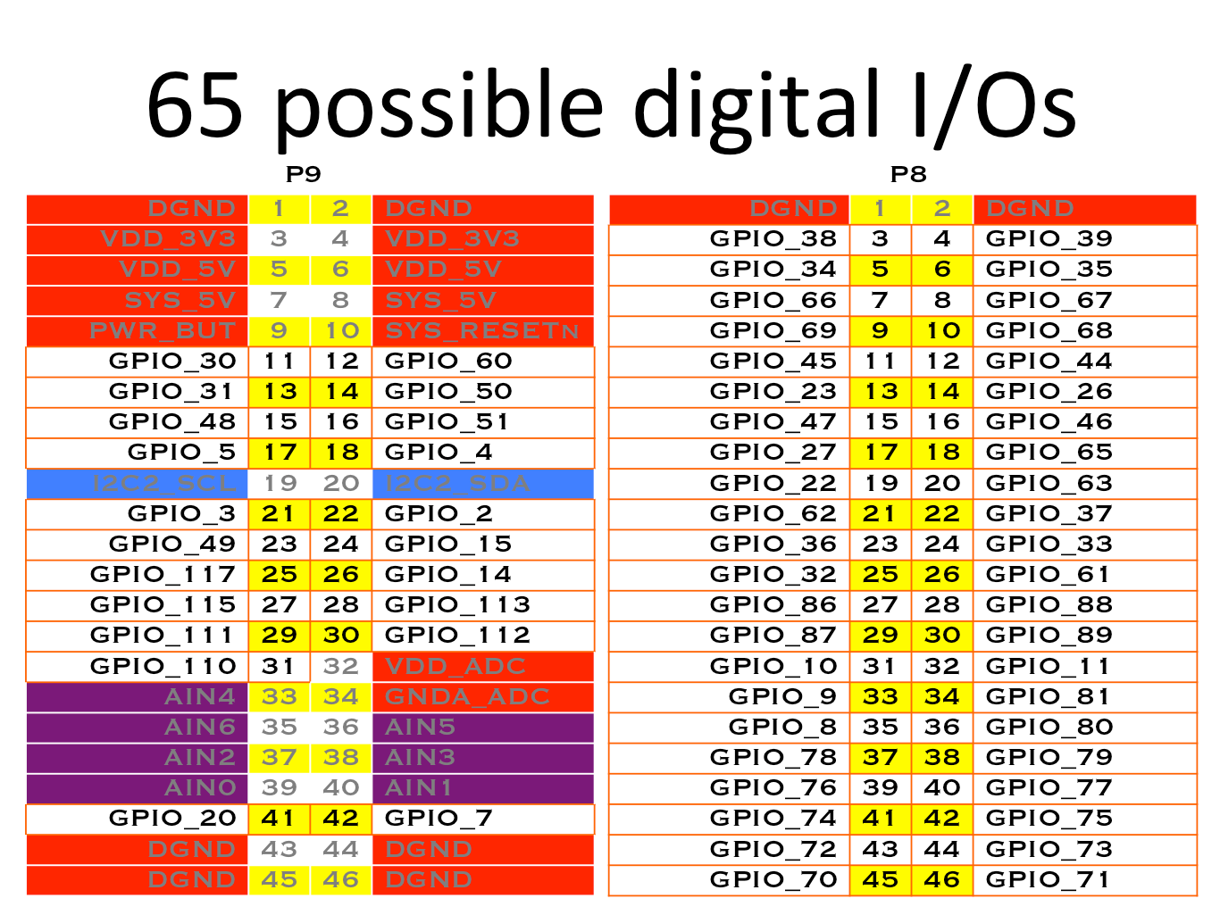
Peripheral – GPIO: Basic Electrical Information
Input -
High (1) : voltage >= 2 V
Low (0) : voltage <= .8 V
Output
High (1) : 3.3 V
Low (0) : 0 V
<number>

Slide 20
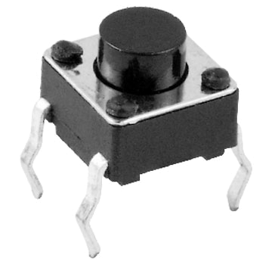
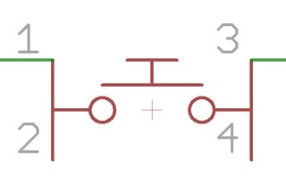
Hardware - Push Button: Introduction
Basic Switch – by default pins 1 and 2 are not connected to pins 3 and 4.
<number>

Slide 21
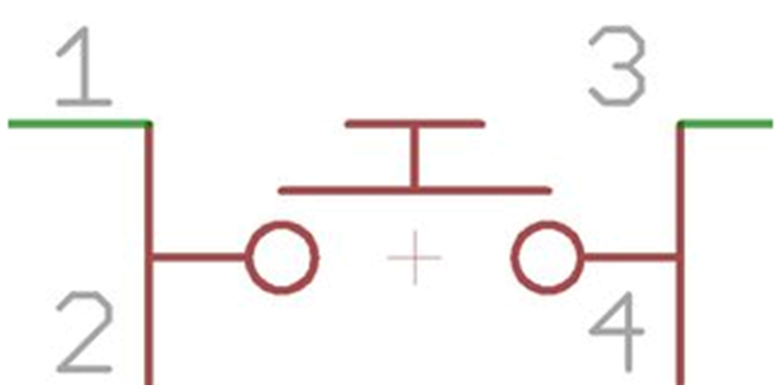
Hardware – Push Button: Wiring
BBB Header Pin P9_29 is connected to one side of tactile switch. VCC is connected to other side of tactile switch.
P9_29
+3.3V
<number>

Slide 22
Quiz 1 - GPIO
What is the value of a input pin when nothing is driving it (outputting a voltage to it)?
<number>

Slide 23
Quiz 1 - GPIO
What is the value of a input pin when nothing is driving it (outputting a voltage to it)?
NO ONE KNOWS
<number>

Slide 24

Hardware – Pullup and Pull Down Resistors
Typical Usage:
Provide a steady/default value
BBB Pin Configuration:
Supports internal pullup and internal pulldown
Adafruit library allows you to configure internal pull up and pull down
P9_29
+3.3V
<number>

Slide 25
Adafruit Library – Quick Introduction
Adafruit created a peripheral library for BBB:
Python Based
Simple to Use
Lose some flexibility
<number>

Slide 26
Adafruit Library – GPIO (Input)
Including/Import
import Adafruit_BBIO.GPIO as GPIO
Configuration:
GPIO.setup(“<PIN_NAME>”, GPIO.IN)
Configures GPIO as an input (pull up resistor by default)
GPIO.setup(“<PIN_NAME>”, GPIO.IN, pull_up_down=GPIO.PUD_DOWN)
Configures GPIO as an input (pull down by default)
Usage:
GPIO.input(“<PIN_NAME>”)
Returns 1/True if voltage is high and returns 0/False if voltage is low
<number>

Slide 27
Adafruit Library – GPIO (Output)
Including/Import
import Adafruit_BBIO.GPIO as GPIO
Configuration:
GPIO.setup(“<PIN_NAME>”, GPIO.OUT)
Configure pin as an output
Usage:
GPIO.output(“<PIN_NAME>”, GPIO.HIGH)
Set pin to high
GPIO.output(“<PIN_NAME>”, GPIO.LOW)
Set pin to low
<number>

Slide 28
Task 5 – Basic GPIO Program
Goal: print a message every time you push the button
Open gpio_input.py file that you previously loaded into Cloud 9.
Replace all the lines that says ## PUT YOUR CODE HERE ## with your code
Read the comment to understand what your being asked to do for the lines your writing code for
Use the information I provided in the previous slides to do this
Run the program and tap the button quickly to see if you achieve your goal
Remember:
Try:
Tap push button once as fast as possible and see what your program outputs
P9_29
+3.3V
Configure internally
<number>

Slide 29
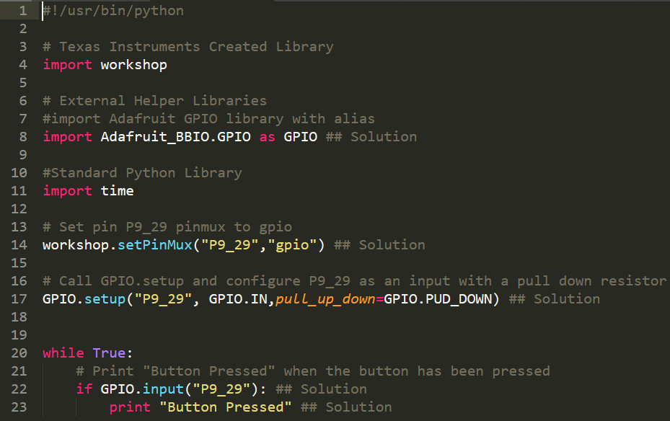
Task 5 – Basic GPIO Program (Solution)
<number>

Slide 30
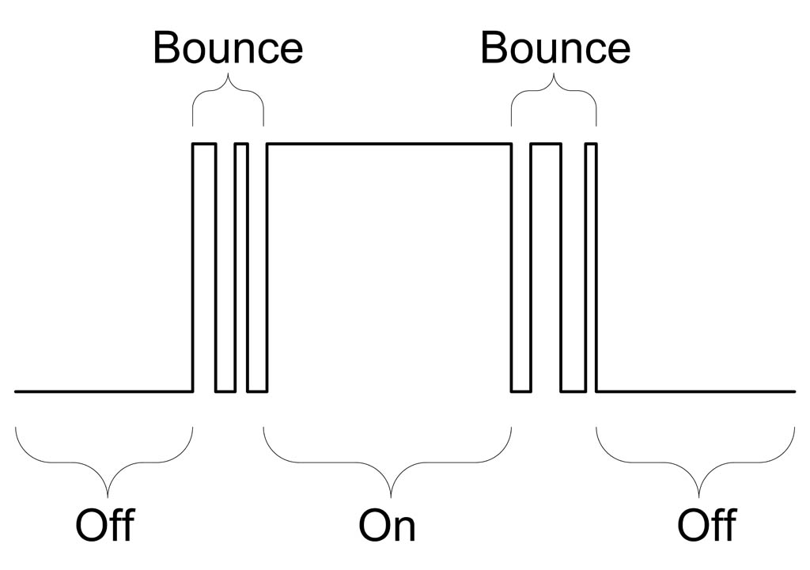
Hardware - Debounce
Switch Bouncing:
Occurs when pushing or release buttons/switch
<number>

Slide 31
Hardware – Debounce Solution
Simple software solution:
When state change ignore any future state changes for X ms
Detect button release
Don’t read for X ms
Don’t read for X ms
Detect button press
<number>

Slide 32
Task 6 – Debounce GPIO Program
Goal: print a message ONCE (ie debounce) every time you push the button
Open gpio_input_debounce.py file that you previously loaded into Cloud 9.
Replace all the lines that says ## PUT YOUR CODE HERE ## with your code
Read the comment to understand what your being asked to do for the lines your writing code for
Use the information I provided in the previous slides to do this
Run the program and tap the button quickly to see if you achieve your goal
Remember:
Try:
Feel free to change the debounce timeout value to see how it impacts the program
P9_29
+3.3V
Configure internally
<number>

Slide 33
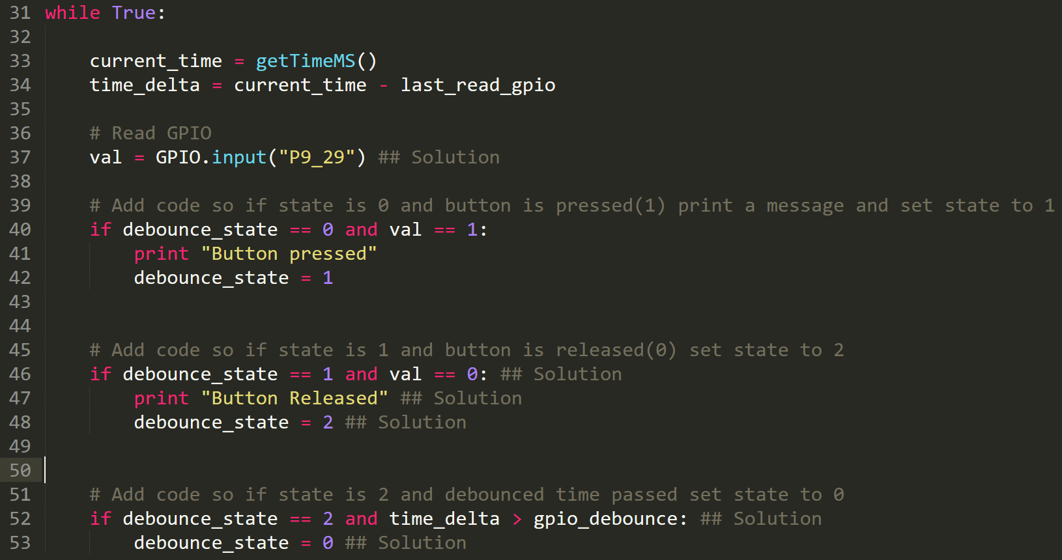
Task 6 – Debounce GPIO Program Solution
<number>

Slide 34
Task 7 – Update Bopit to use Push Button
If bopit.py is running make sure you stop it.
Open bopit.py file that you previously loaded into Cloud 9.
Replace all the lines that says “## PUT YOUR CODE HERE ##” within the functions “gpioSetup()” and getPushButtonVal()”.
Read the comment to understand what your being asked to do for the lines your writing code for. Your pretty much taking the code you wrote before and adding it here.
Run bopit.py program
Go to http://192.168.7.2:8080/workshop/bopit/
If things are working properly every time it says push it you can use the push button the Beaglebone
<number>

Slide 35

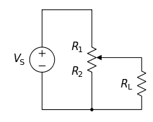
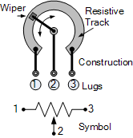
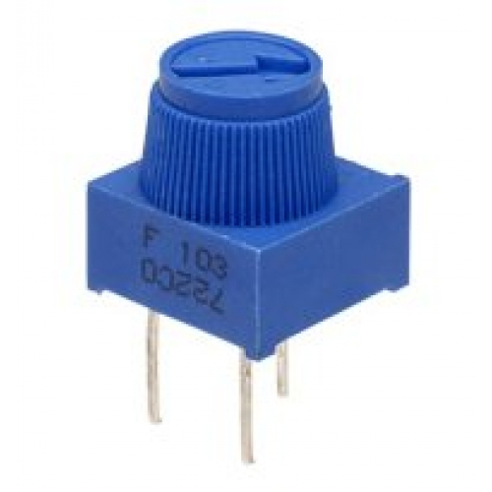
Hardware: Potentiometer
What is it:
Variable Resistor
Increase/decrease resistance via knob
Can be used as a voltage divider
Middle pin is output of divider
<number>

Slide 36
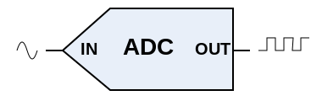
Peripheral – Analog to Digital Converter (ADC)
Purpose
Converts analog voltage to digital value
Useful for sensors that output voltage only
Beaglebone Black's ADC is a 12 bit ADC:
Digital Value Range
0 – 4095
Max support input voltage:
1.8 V
<number>

Slide 37
Adafruit Library – ADC
Including/Import
import Adafruit_BBIO.ADC as ADC
Configuration:
ADC.setup()
Usage:
ADC.read(“<PIN_NAME>”)
Returns a decimal value from 0.0 – 1.0
ADC.read_raw(“<PIN_NAME>”)
Returns a digital value from 0 - 4095
<number>

Slide 38
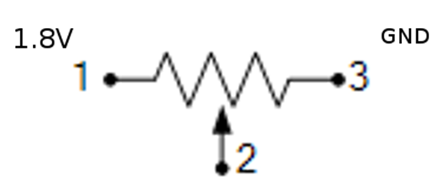
Task 8 – Read Potentiometer
Goal: Print the voltage being read by the potentiometer
Open adc.py file that you previously loaded into Cloud 9.
Replace all the lines that says ## PUT YOUR CODE HERE ## with your code
Read the comment to understand what your being asked to do for the lines your writing code for
Use the information I provided in the previous slides to do this
Run the program and tap the button quickly to see if you achieve your goal
Remember:
P9_36

Slide 39
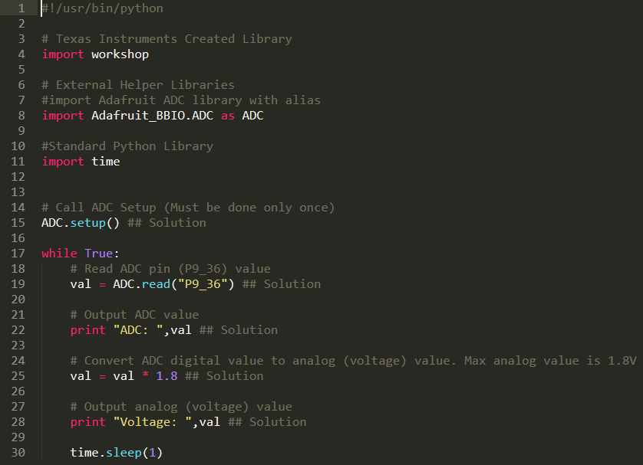
Task 8 – Read Potentiometer Solution
<number>

Slide 40
Task 9 – Update Bopit to use Potentiometer
If bopit.py is running make sure you stop it.
Open bopit.py file that you previously loaded into Cloud 9.
Replace all the lines that says “## PUT YOUR CODE HERE ##” within “adcSetup()” and “readPotentiometerVal()” function.
Read the comment to understand what your being asked to do for the lines your writing code for. Your pretty much taking the code you wrote before and adding it here.
Run bopit.py program
Go to http://192.168.7.2:8080/workshop/bopit/
If things are working properly every time it says push it you can use the push button, and when it says twist it you can twist the potentiometer (make sure you twist it by a good amount
<number>

Slide 41
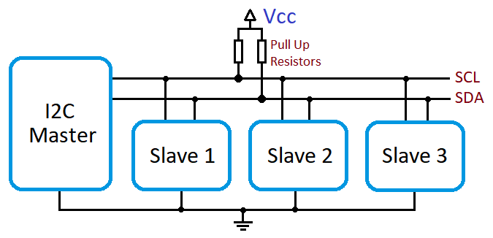
Peripheral – I2C Quick Summary
Quick Summary
Uses 2 Pins
SCL – Clock
SDA – Data
Half Duplex
Speed “Typical” Ranges 1K to 400K
Supports Multiple Nodes
Communicate to specific node via unique address
Multi Master
<number>

Slide 42
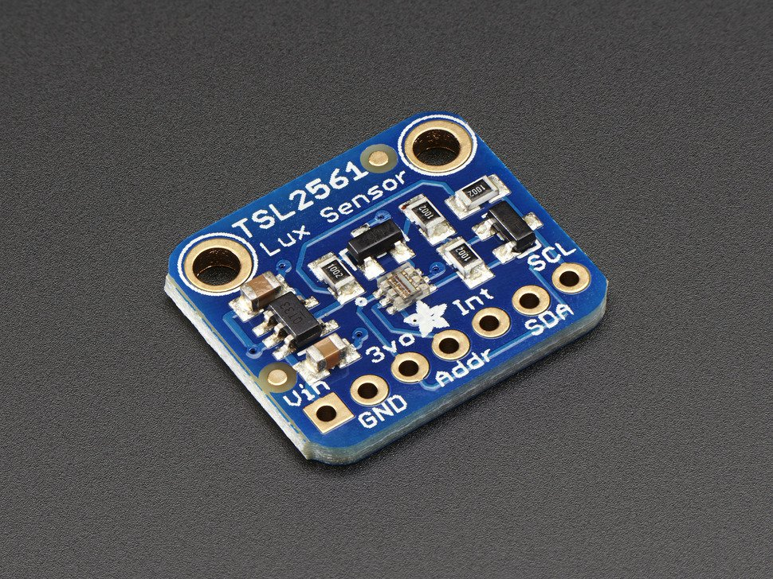
Hardware – Light Intensity Sensor
Summary:
Default address 0x29
Requires Configuration
Has defined sample rate
Returns ambient light
levels
<number>

Slide 43
Task 10 – I2C Light Intensity
Goal: print light intensity every second
Open i2c.py file that you previously loaded into Cloud 9.
Replace all the lines that says ## PUT YOUR CODE HERE ## with your code
Update the code based on the comments that explain what is expected.
Use the information I provided in the previous slides to do this as well as the smbus pdf included in the bopit.zip you extracted earlier.
Run the program and tap the button quickly to see if you achieve your goal
Remember/Hint:
Device is on bus 2
Device address is 0x29
Try:
Feel free to change the debounce timeout value to see how it impacts the program

Slide 44
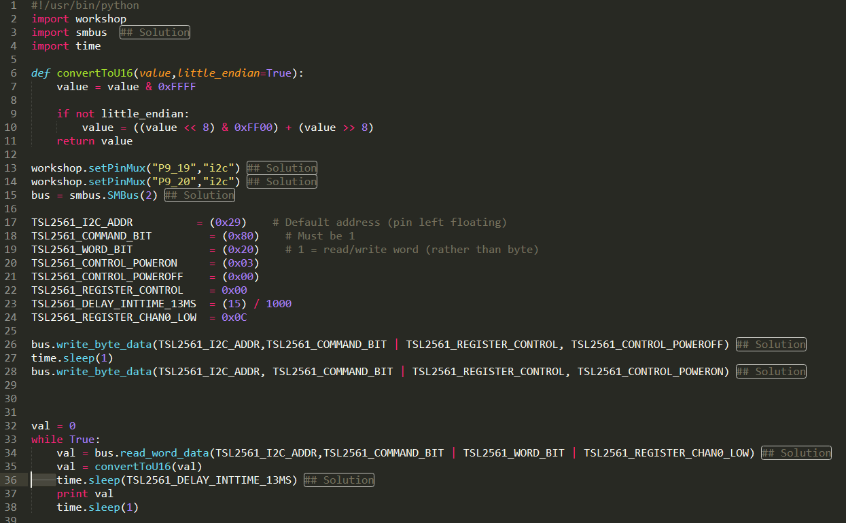
Task 10 – I2C Light Intensity Solution

Slide 45
Task 11 – Update Bopit to use Light Sensor
If bopit.py is running make sure you stop it.
Open bopit.py file that you previously loaded into Cloud 9.
Replace all the lines that says “## PUT YOUR CODE HERE ##” with your code within functions “i2cSetup()” and “getLightValue()”.
Read the comment to understand what your being asked to do for the lines your writing code for. Your pretty much taking the code you wrote before and adding it here.
Run bopit.py program
Go to http://192.168.7.2:8080/workshop/bopit/
If things are working properly every time it says push it you can use the push button, when it says twist it you can twist the potentiometer (make sure you twist it by a good amount and when it says block it you put your hand over the light sensor.
<number>

